Slide 1
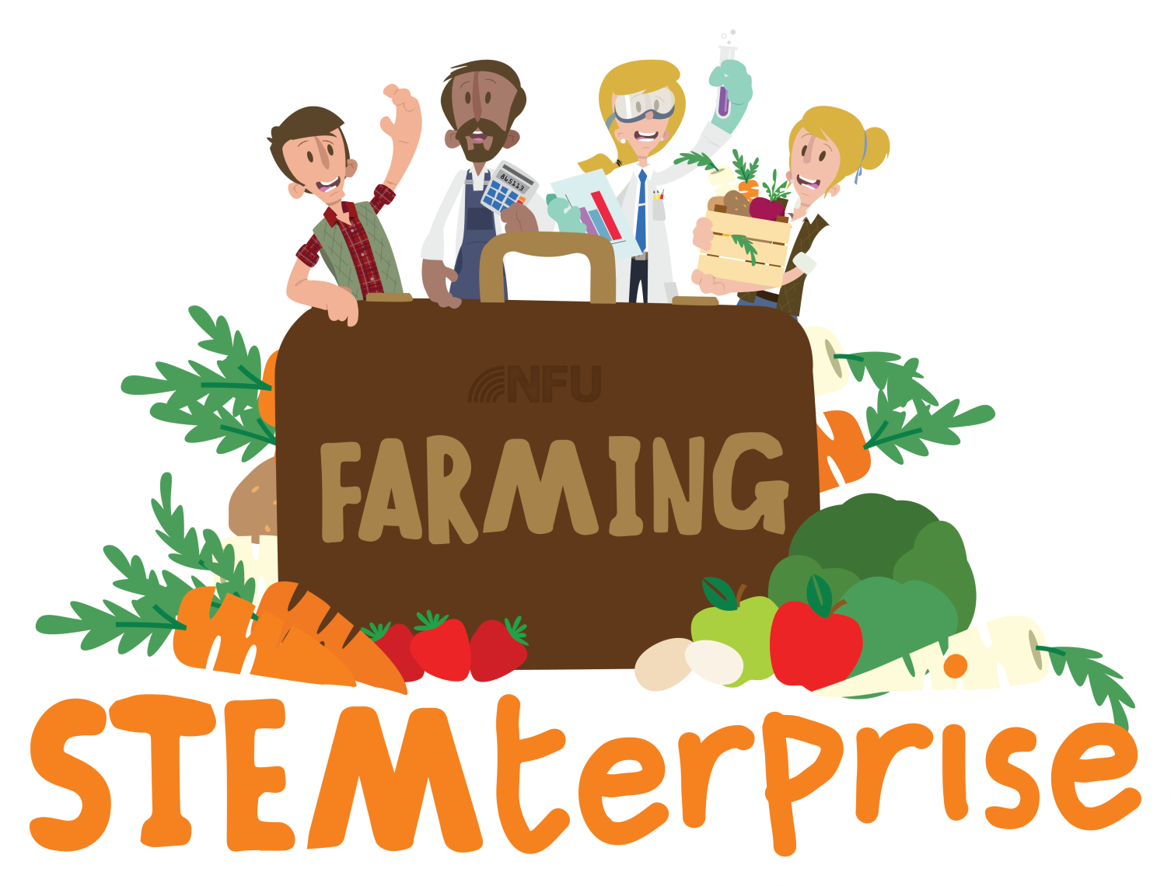
Stage 2: Where do our ingredients come from?

Slide 2
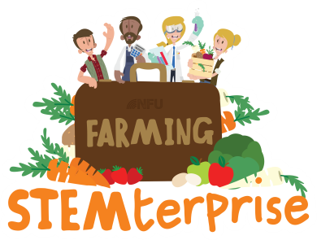
Where do our ingredients come from?
All the ingredients we are going to use for our yoghurt cafes will have been grown or produced in Britain.
Using ingredients that are grown in Britain is one way that we can care for the environment because it reduces how far the food has to travel to reach our plates. This reduces the need for transport, reducing air pollution.
Before we start making our delicious yoghurt flag desserts for our cafes, we are going to learn where all of our ingredients have come from.

Slide 3
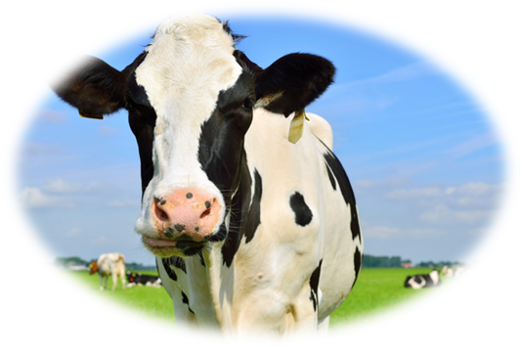
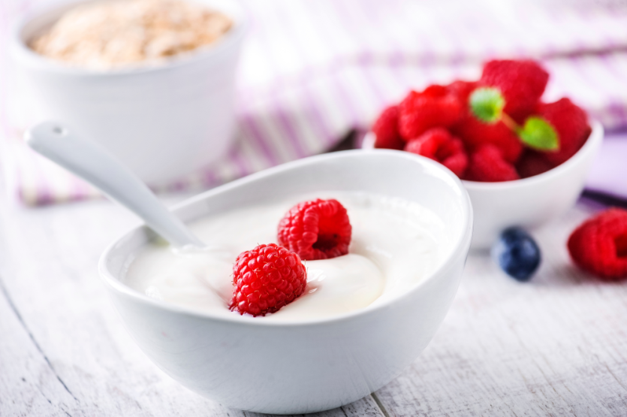
Yoghurt
Yoghurt is a dairy product.
Dairy products are made from milk. Where does milk come from?
Milk comes from dairy cows and special, harmless bacteria are added to turn it into yoghurt.

Slide 4
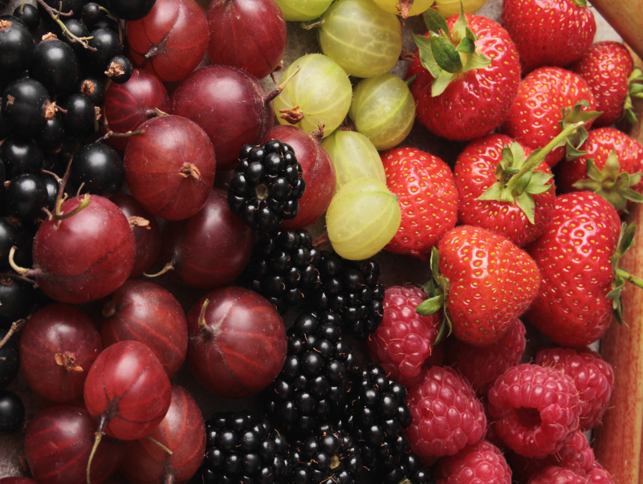
Fruit
How many fruits can you think of?
Do you know where fruit comes from?
Fruit and vegetables are grown by farmers planting tiny seeds. If they are given everything they need to be healthy, these seeds will grow into plants and trees that will give us fruits and vegetables.

Slide 5
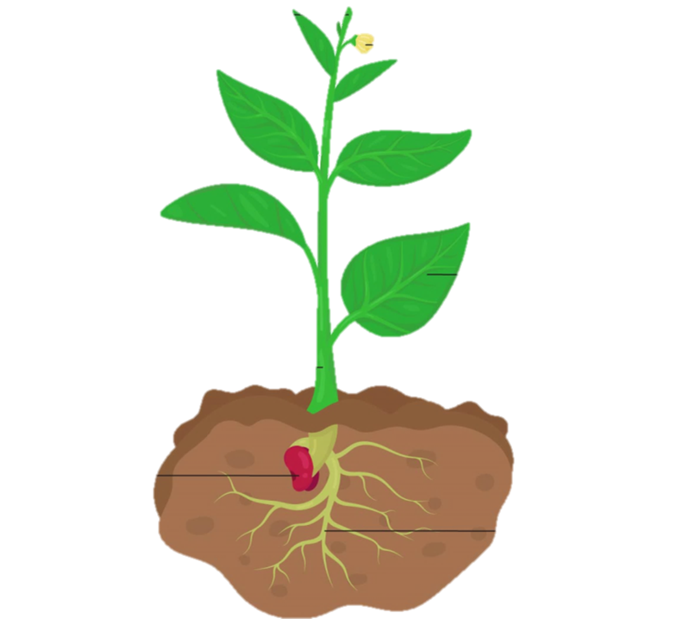
Parts of a plant
Can you name any of the parts of this plant?

Slide 6
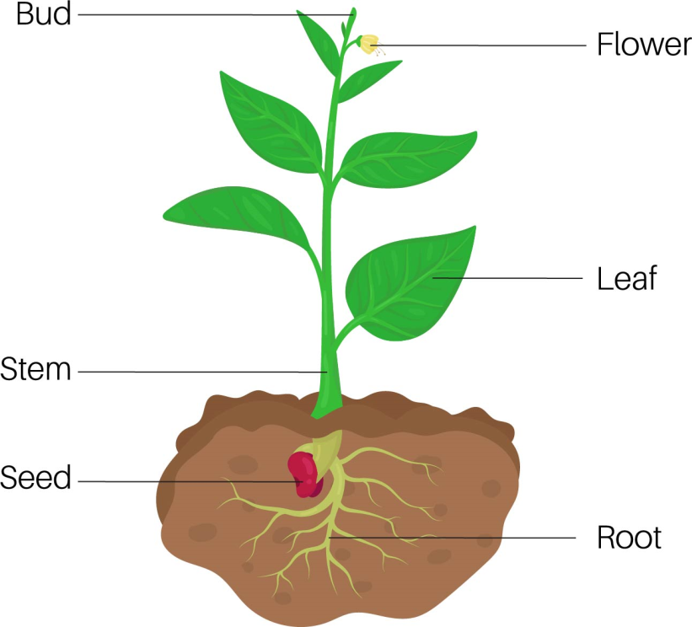
Parts of a plant
Can you name any of the parts of this plant?

Slide 7
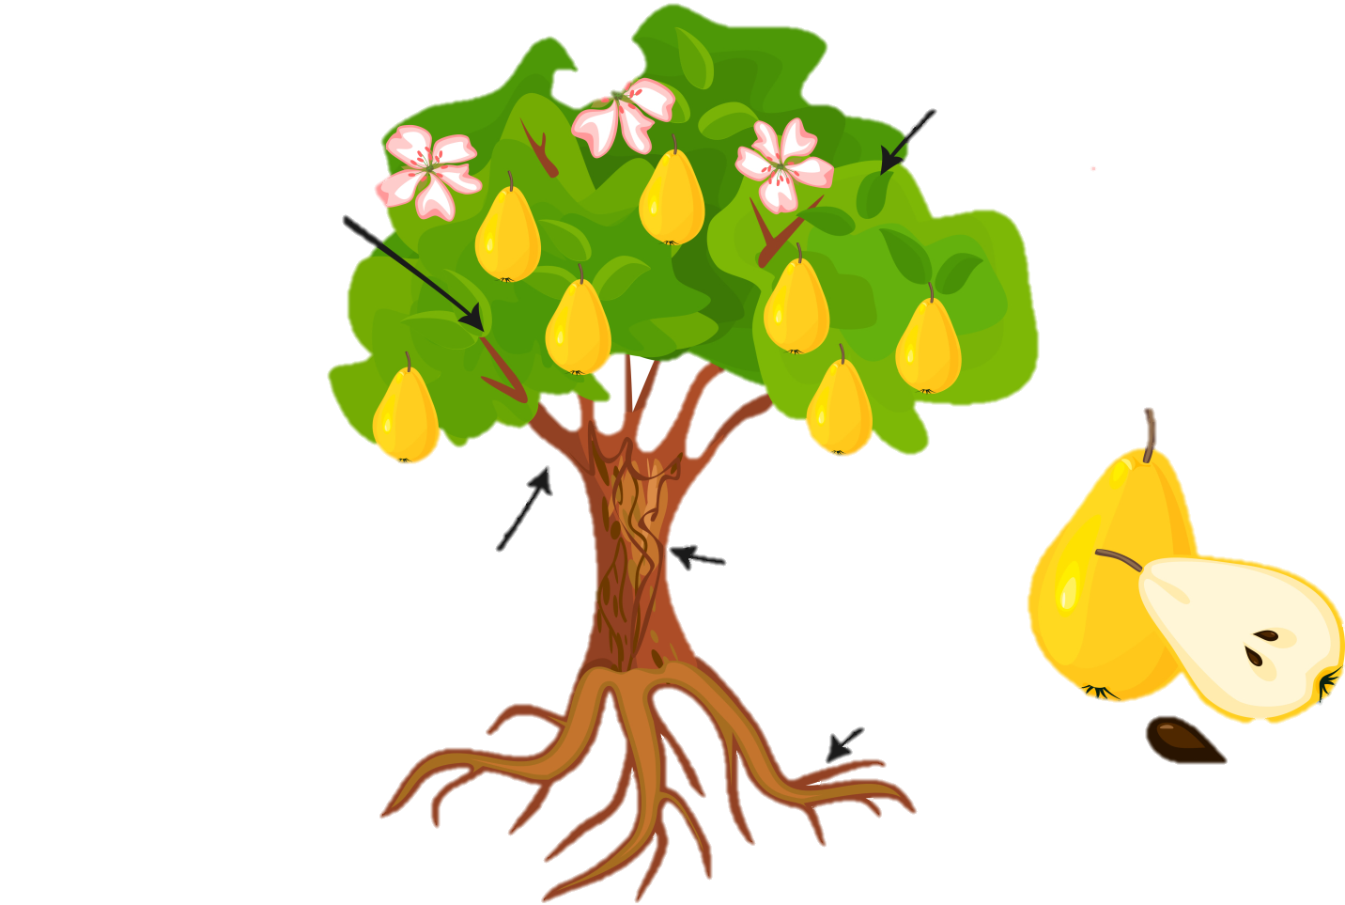
Parts of a tree
Can you name any of the parts of this tree?

Slide 8
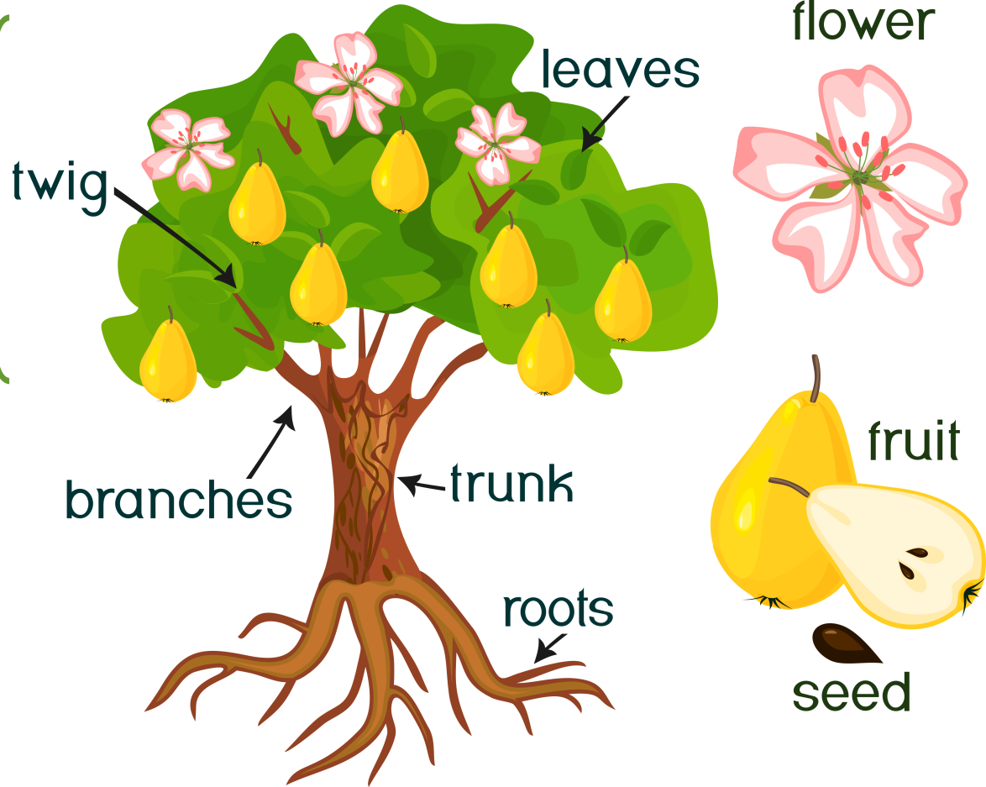
Parts of a tree
Can you name any of the parts of this tree?

Slide 9
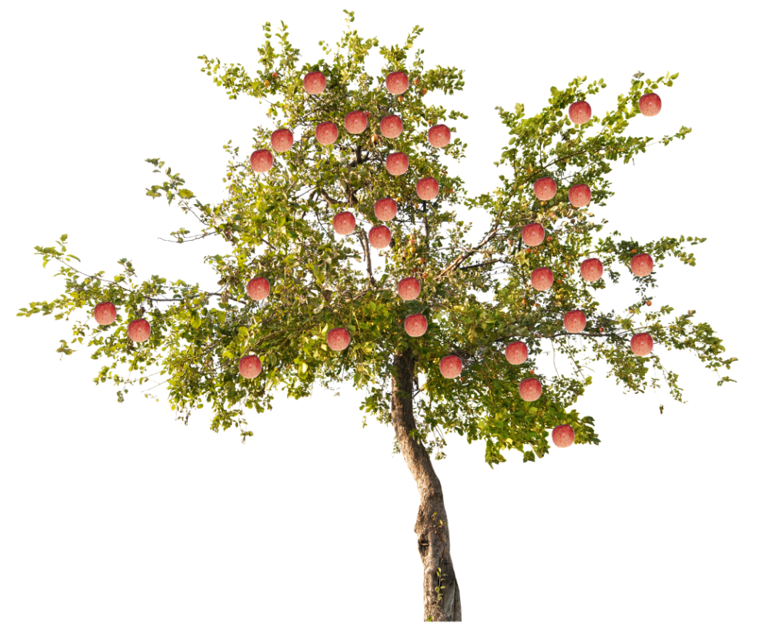
Where do apples come from?
Apples grow on apple trees.

Slide 10
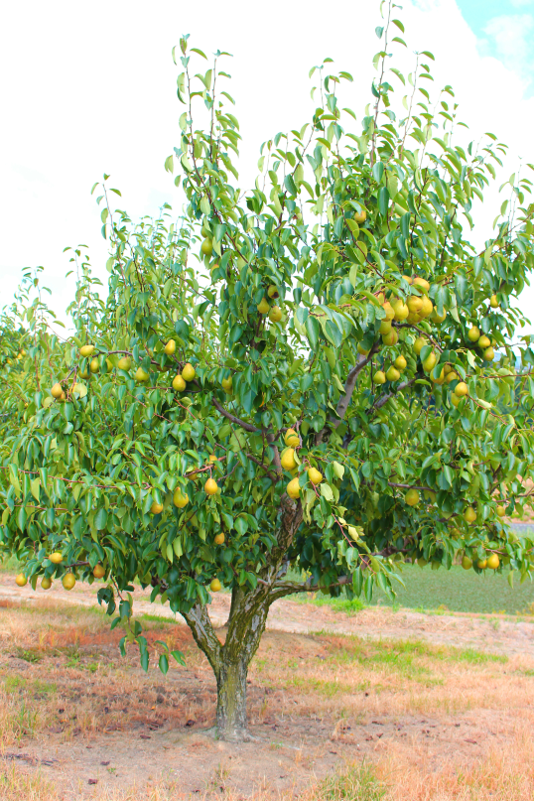
Where do pears come from?
Pears grow on pear trees.

Slide 11
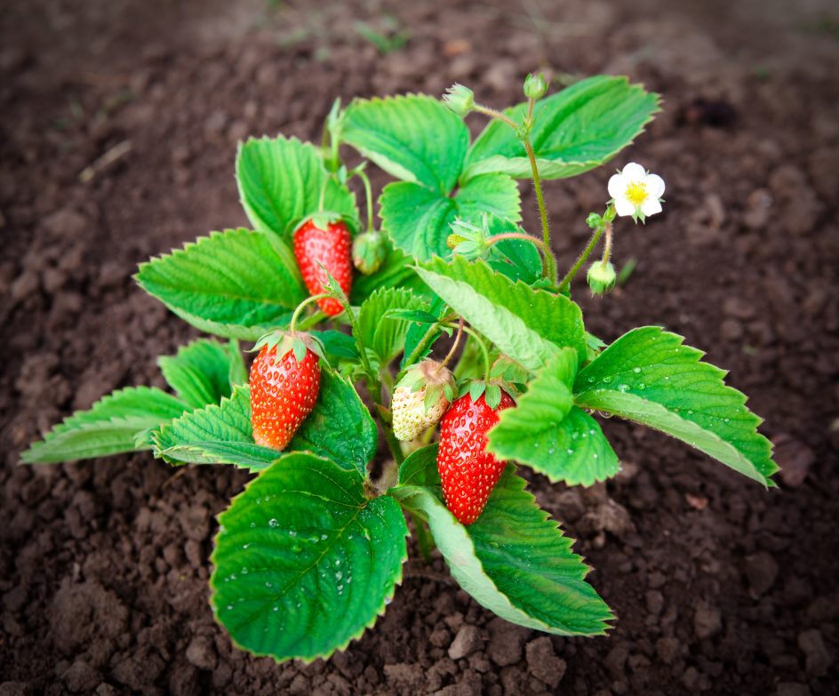
Where do strawberries come from?
Strawberries grow on strawberry plants.

Slide 12
Where do grapes come from?
Grapes grow on grape vines.

Slide 13
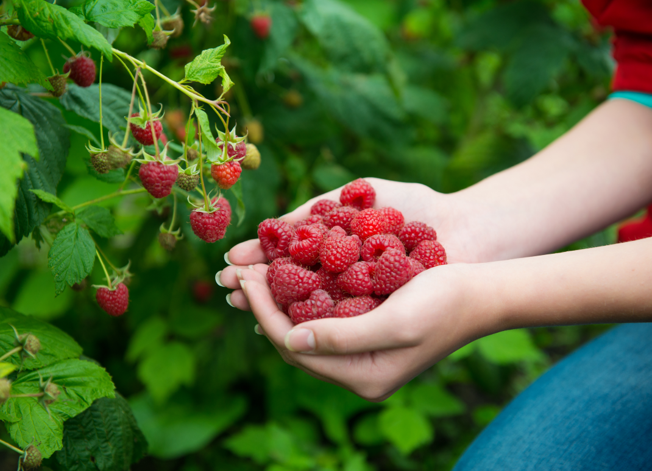
Where do raspberries come from?
Raspberries grow on raspberry bushes.

Slide 14
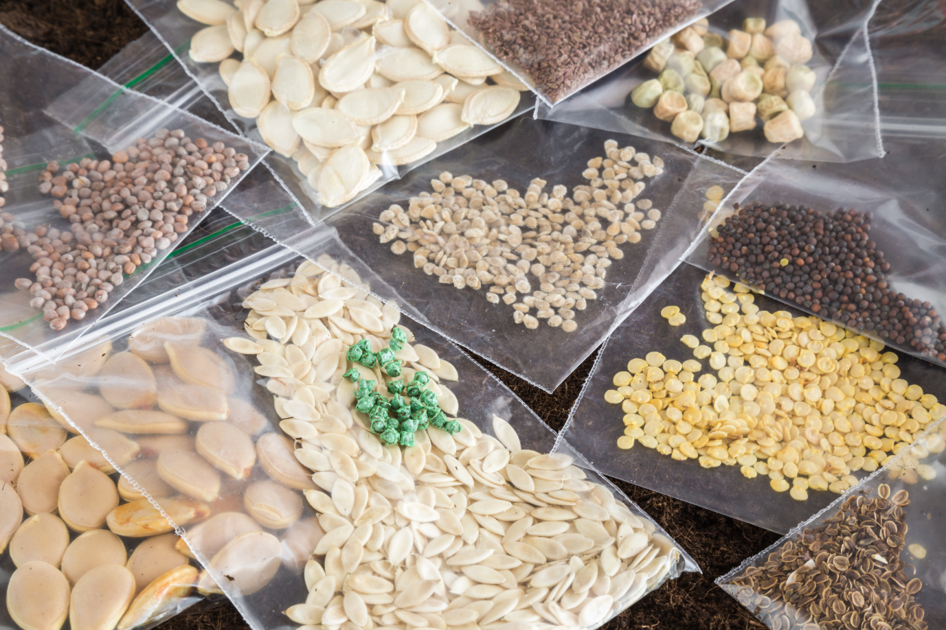
Let’s explore some seeds!

